Slide 1
Food Basket
Mareddy Aruna
Vudutha Krishna Teja
Alle Sai Aravind
Cheeli David Raju
Chava Naveen
Giramoni Pavan
Rasamsetti Lakshmaiah

Slide 2
Introduction
Technologies Used:
Angular
Spring Boot
MySQL

Slide 3
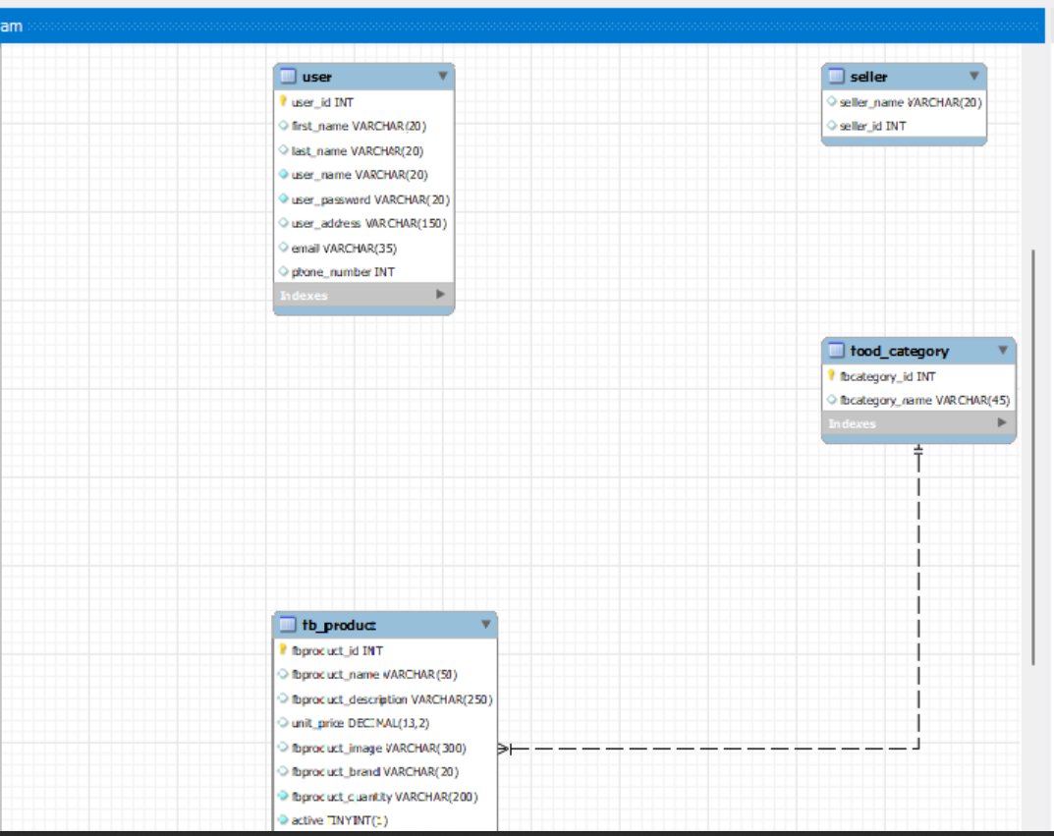
Database

Slide 4
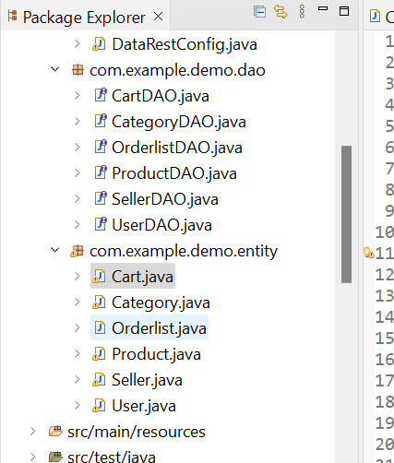
Spring Implementation

Slide 5
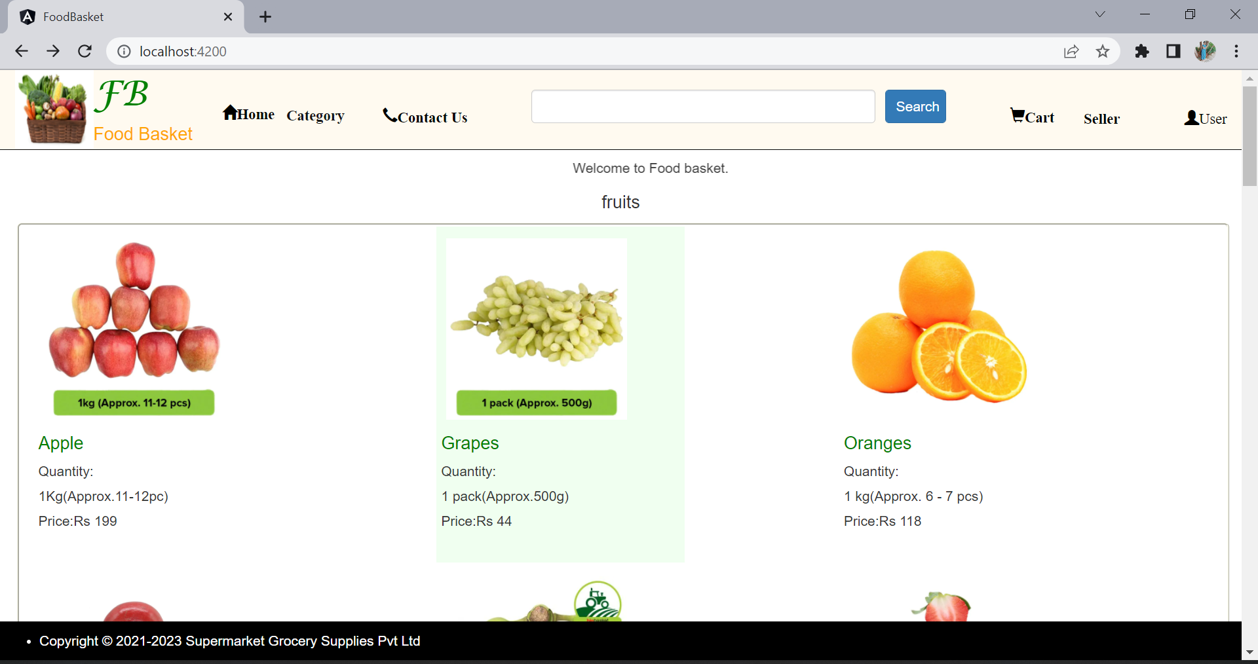
Home Page

Slide 6
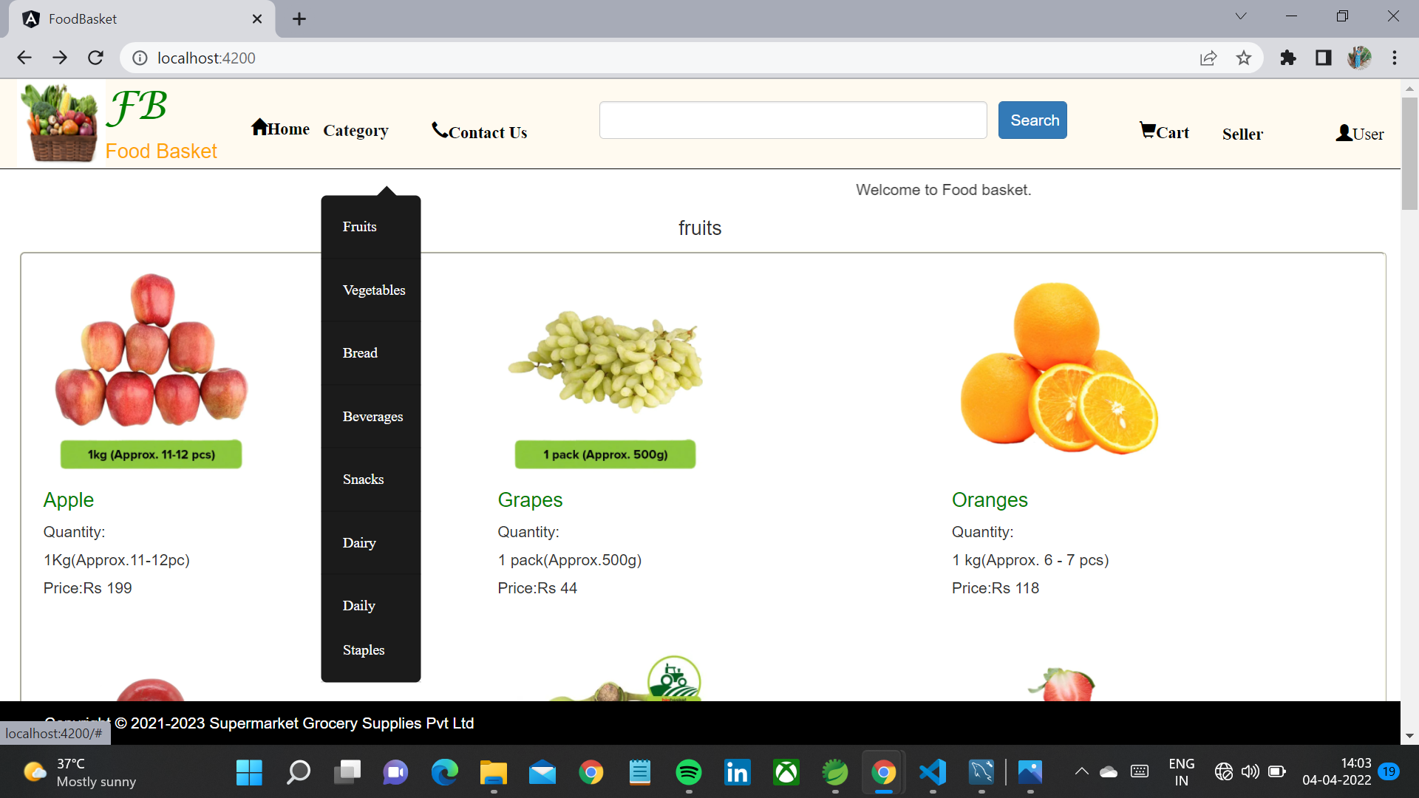
Category

Slide 7
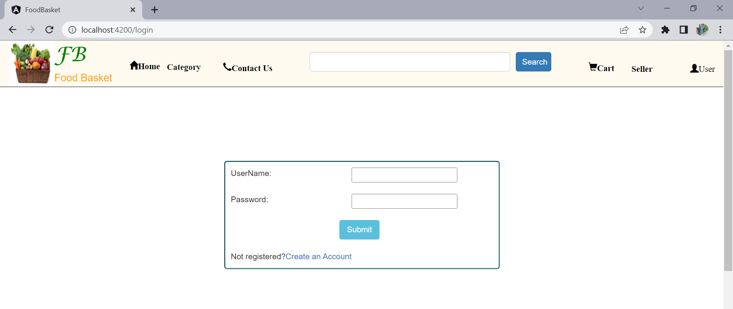
User Login

Slide 8
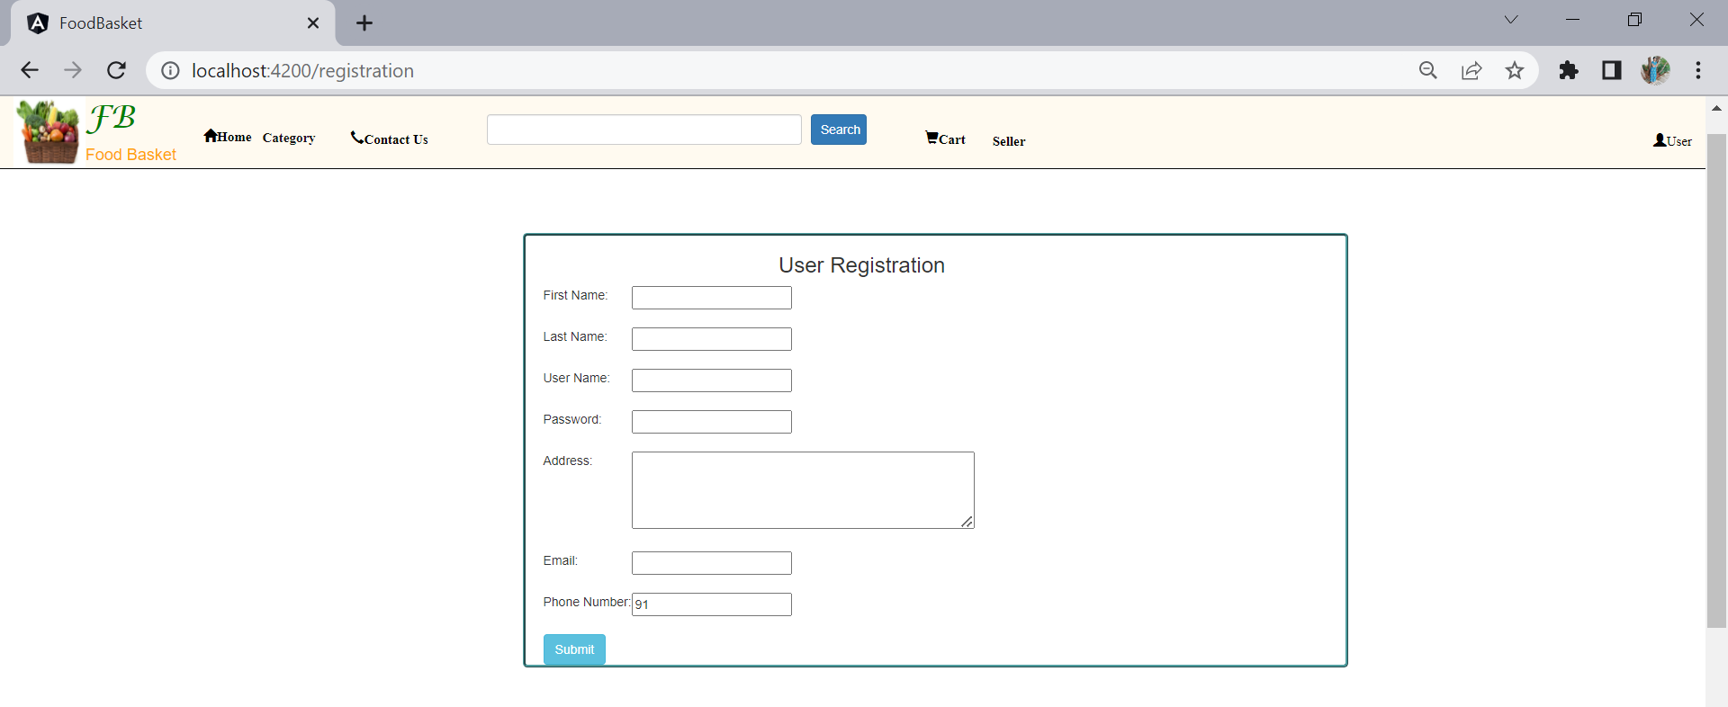
User Registration

Slide 9
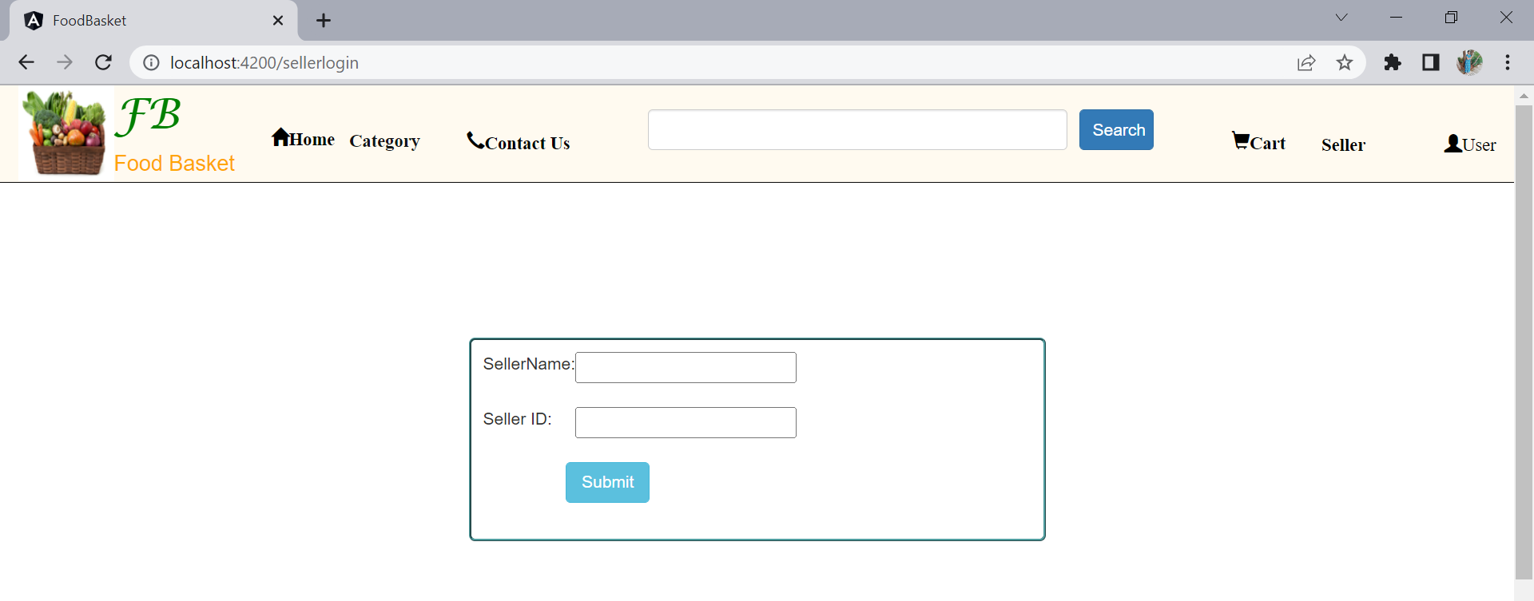
Admin Login

Slide 10
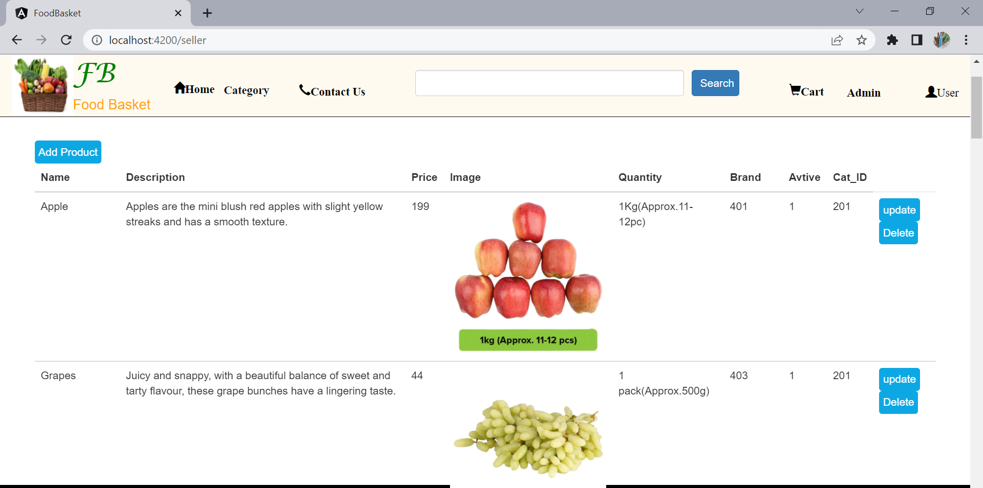
Admin page

Slide 11
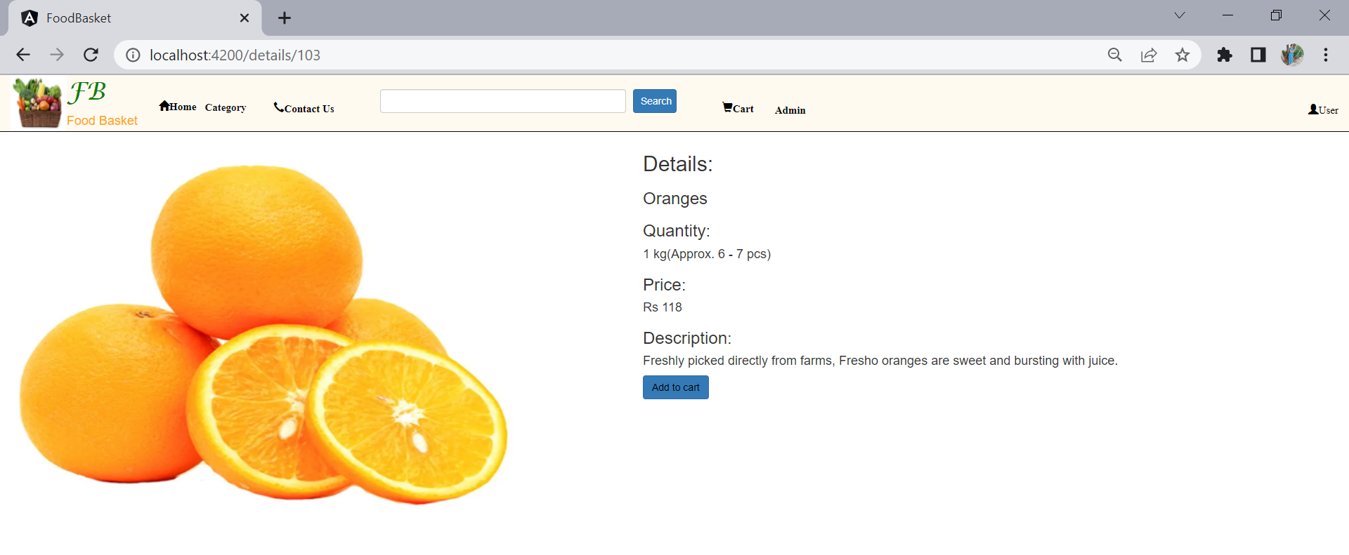
Product Details Page

Slide 12
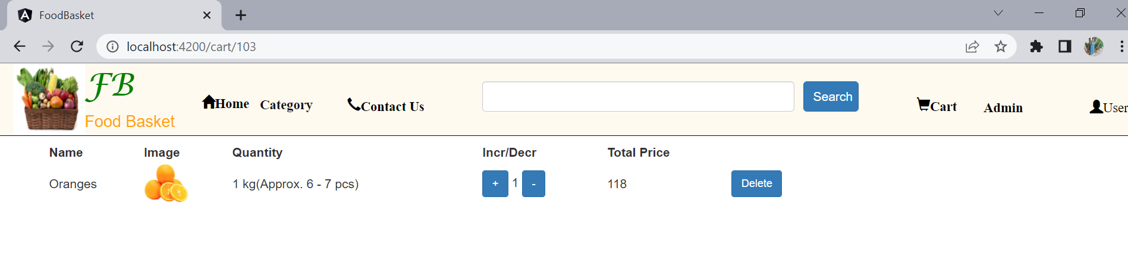
Add To Cart

Slide 13
Thank You

